Slide 1
Predicting Bank Defaults
Jonathan harpula

Slide 2
Problem Statement
In the last 6 months, 22% of loans given out have defaulted
What are the factors causing these defaults?
Can we predict defaults before they happen?
What actions can be put in place to mitigate future losses from defaults?

Slide 3
The Data
The data contains qualitative and quantitative independent variables as well as one categorical dependent variable (Did the loan default Y/N?)
Data Includes Demographics (Age, Gender, Marital Status, Education), Loan Amount, Repayment Status (Ontime vs. Late), Bill Amount, Payment Amount, and if the loan defaulted or not.

Slide 4
Data Details (Technical)
ID: ID of each client
LIMIT_BAL: Loan Amount
SEX: 1=male, 2=female
EDUCATION: 1=graduate school, 2=university, 3=high school, 4=others, 5=unknown, 6=unknown
MARRIAGE: 1=married, 2=single, 3=others
AGE: In Years
PAY_0: Repayment status in Sep, 2005- Categorical
PAY_2: Repayment status in Aug, 2005- Categorical
PAY_3: Repayment status in Jul, 2005- Categorical
PAY_4: Repayment status in Jun, 2005- Categorical
PAY_5: Repayment status in May, 2005- Categorical
PAY_6: Repayment status in Apr, 2005- Categorical
BILL_AMT1: Amount of bill statement in September, 2005
BILL_AMT2: Amount of bill statement in August, 2005
BILL_AMT3: Amount of bill statement in July, 2005
BILL_AMT4: Amount of bill statement in June, 2005
BILL_AMT5: Amount of bill statement in May, 2005
BILL_AMT6: Amount of bill statement in April, 2005
PAY_AMT1: Amount of previous payment in September, 2005
PAY_AMT2: Amount of previous payment in August, 2005
PAY_AMT3: Amount of previous payment in July, 2005
PAY_AMT4: Amount of previous payment in June, 2005
PAY_AMT5: Amount of previous payment in May, 2005
PAY_AMT6: Amount of previous payment in April, 2005
default payment next month: Default payment (1=yes, 0=no)

Slide 5
Data Wrangling
Data was pretty clean upon download (No missing values)
Needed to reclassify Marriage and Education
Imported Pandas and Numpy
Imported File using read_excel. Changed header row to 1
Data Types – All integers
Check for missing data: None
Check for duplicate data: All unique
Split into two data frames later to compare default vs nondefault.

Slide 6
Exploratory Data Analysis (Non-Technical)
Initial Findings from an initial look at the data through visualizations
22% of loans have defaulted
Smaller loans tend to default more.
Men default at a higher rate than woman
Married couples default at a slightly higher rate than singles
Defaults over Education were similar though high school educated does default slightly more
Not surprisingly, those who are late with payments and those who make lessor payments default at a higher rate.
Age has little effect on default rates.

Slide 7
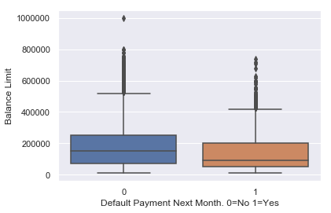
Exploratory Data Analysis 1
Mean and quartiles for defaults are lower than nondefaults
Are the banks standards for low balance loans too lenient?

Slide 8
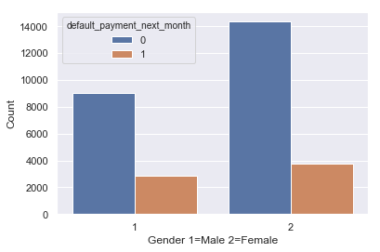
Exploratory Data Analysis 2
Men tend to default at a higher level.
Ethical question #1: Are we holding women to a higher lending standard than men? Is there bias in our lending practices?

Slide 9
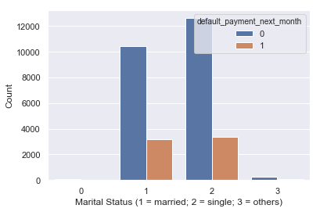
Exploratory Analysis 3
Married defaults at a slightly higher rate than singles.
Is this significant enough to look into?

Slide 10
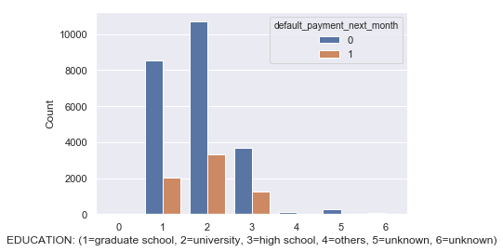
Exploratory Data Analysis 4
Defaults over education level are steady.
High School defaults at a slightly higher rate.

Slide 11
Exploratory Data Analysis 6
Not surprisingly, late payments ultimately lead to higher rates of defaults.
Slight surprise: Loans are defaulting right from the first month. This ties into the loan policy question raised before.
Details on the next slide

Slide 12
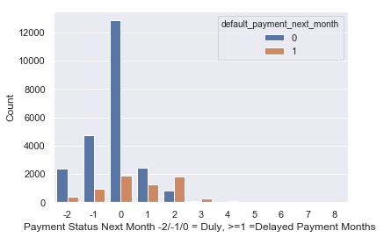
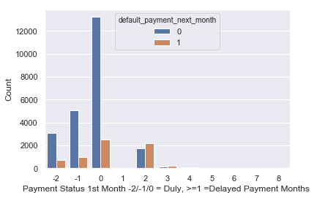
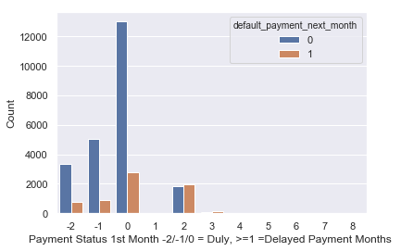
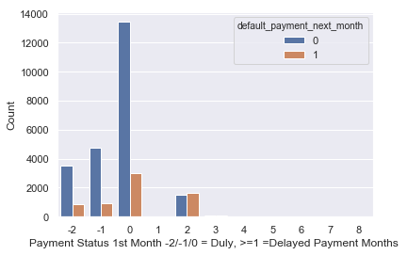
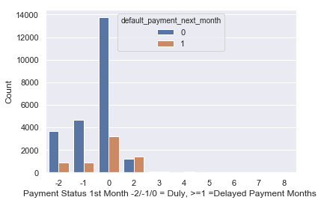
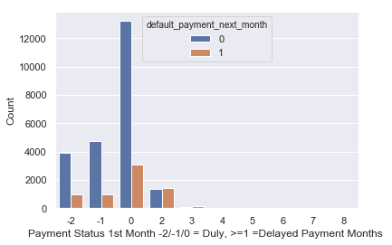

Slide 13
Exploratory Data Analysis 7
Paying less per loan does increase default rates (not a surprise)
This, combined with lower term loan defaults, should be looked into.
Details on the next slide.

Slide 14
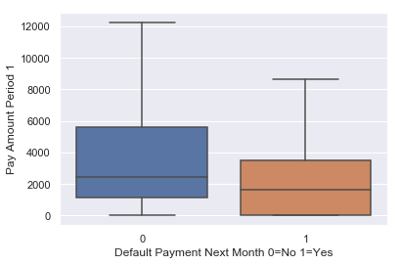
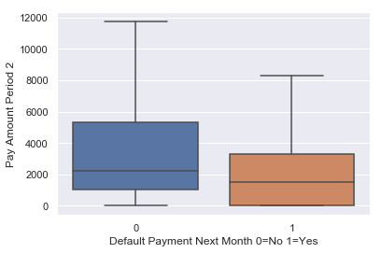
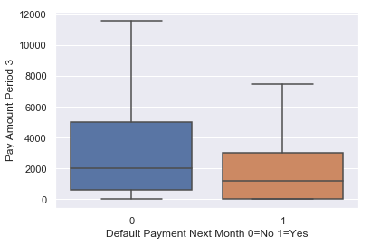
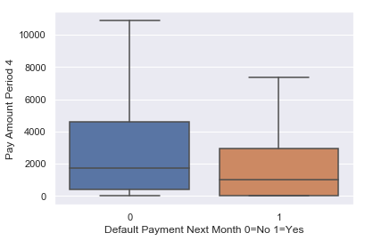

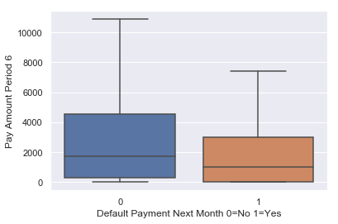

Slide 15
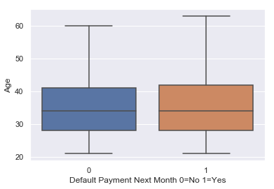
Exploratory Data Analysis 8
Age does not seem to have a large affect on defaults.

Slide 16
Statistical Inference: Correlations
default_payment_next_month
PAY_1 0.324794
PAY_2 0.263551
PAY_3 0.235253
PAY_4 0.216614
PAY_5 0.204149
PAY_6 0.186866
EDUCATION 0.028006
AGE 0.013890
BILL_AMT6 -0.005372
BILL_AMT5 -0.006760
BILL_AMT4 -0.010156
BILL_AMT3 -0.014076
default_payment_next_month
BILL_AMT3 -0.014076
BILL_AMT2 -0.014193
BILL_AMT1 -0.019644
MARRIAGE -0.024339
SEX -0.039961
PAY_AMT6 -0.053183
PAY_AMT5 -0.055124
PAY_AMT3 -0.056250
PAY_AMT4 -0.056827
PAY_AMT2 -0.058579
PAY_AMT1 -0.072929
LIMIT_BAL -0.153520

Slide 17
Statistical Inference Summary
The largest correlations lie with the Payment Status
Shown visually as well
The largest negative correlation lies with the loan amount
Shown visually. Smaller loans have higher default rates.

Slide 18
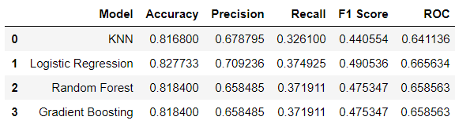
Machine Learning Models
Create Training, Test Sets
Use the Training Sets on each of the following ‘out of the box’ models
K Nearest Neighbors
Logistic Regression
Random Forest
Gradient Boosting
Best Performing Model: Logistic Regression

Slide 19
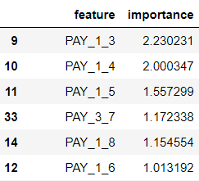
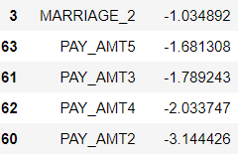
Influential Features
Payment Status and amount are the most important features when deciding if a client will default
This makes sense: Those who pay off their loans and do not fall behind will default less!

Slide 20
Are we happy with these models?
Why Yes
Why No
We can predict with 81% accuracy if an account will default next month.
The most important features have been identified and immediate action can be taken to work with these accounts.
While we have an 81% accuracy, our ROC curve ( 66.5) modestly better than 0.5 (a coin flip).
Unbalanced data can explain the gap.

Slide 21
Room for Improvement
What can be done to improve our predictive models?
Is there a better ‘out of the box’ model we can use? (ie Deep Learning)
Hyper-tuning of parameters
Creation of new variables (Payment %?)

